Slide 1

Understanding ESG’s Street Outreach Component
TN Housing Development Agency - August 2024
This Photo by Unknown Author is licensed under CC BY-NC

Slide 2
Street Outreach Objective
Street Outreach activities are designed to meet the immediate needs of people experiencing homelessness in unsheltered locations by connecting them with emergency shelter, housing, or critical services, and providing them with urgent, non-facility-based care.
Goal: supporting households experiencing homelessness in achieving permanent, sustainable housing.

Slide 3
Minimum Period of Use
Street Outreach services must be provided for at least the period of time for which ESG funds are committed for that purpose.
  Example: If the recipient commits to providing street outreach for an entire year, or if the recipient contracts with a subrecipient to provide street outreach services for an entire year, then the specified street outreach services must be provided for the entire one-year period.
If awarded, sub-recipients need to be ready to administer their Street Outreach activity right away.

Slide 4
Street Outreach: Core Elements
Housing Focused
Coordinated
Person-Centered
Trauma-Informed & Culturally Responsive
Safety Oriented
As we go through each element, share your Words of Wisdom on how you exemplify each core element in your own Street Outreach activity.

Slide 5
Street Outreach is Housing Focused
The goal of street outreach is to return people to safe, stable permanent housing. Emergency shelter can be a powerful tool, but only if it addresses a specific need or barrier.
Street outreach should adopt a Housing First approach and never impose preconditions such as sobriety or project participation.
Creating, working from, and frequently updating a housing plan can be a great way to operationalize housing focused street outreach.
Asking the question: “What would your ideal housing situation look like if you could have it today?”
Notes:
Do any of you have suggestion or wisdom of how you keep the focus on housing when you are doing street out reach with individuals?

Slide 6
Street Outreach is Coordinated
Street outreach is conducted on behalf of the community rather than one agency, requiring collaboration among multiple stakeholders. Knowledge of and engagement with all partners implementing street outreach efforts leads to more strategic use of resources and more comprehensive coverage and identification of all people experiencing unsheltered homelessness.
Coordinate with the broader network of programs, services, or staff who are likely to encounter individuals experiencing unsheltered homelessness, but whose regular focus is broader than homelessness.
This might include law enforcement and other first responders, hospitals, health and behavioral healthcare providers, child welfare agencies, homeless education liaisons, workforce systems, faith-based organizations, and other community-based providers.
If there are multiple street outreach activities in one area, collaborate with one another to maximize services. Ensure you don’t visit the same areas on the same days or split areas of coverage when possible.
Notes:
Is there anyone who feels that they have a good system in place for collaboration and coordination among agencies that they want to share?

Slide 7
Street Outreach is Person-Centered
Street outreach should use a person-centered approach that seeks to identify and work from each person’s strengths, resources, and support networks. To be consistently successful, street outreach must empower participants to explore many routes to housing to discover what works best for them, including housing subsidies outside Coordinated Entry and routes to housing via existing support networks.
To maximize connections, learn when people experiencing homelessness are present at known sites, heighten urgency when extreme weather is possible, and consider early morning or late evening outreach to reach people before/after jobs begin or people move indoors for climate control.
Where one or more outreach teams work in the same area, it is important to collaborate services by:
  Establishing a lead person/agency that will promote an agreed upon intervention for the individual/family.
  The agency will lead the case management of the homeless individual until either the individual has been re-housed, or a more appropriate case manager is ready to take over.
  Other agencies will reinforce this intervention so that agencies are not working against one another.
Notes:
Is there anyone willing to share some other ideas on how to be more person-centered?

Slide 8

Street Outreach is
Trauma-Informed & Culturally Responsive
Street outreach must be culturally responsive and deploy evidence-based practices including trauma-informed care. Homelessness is traumatic, and outreach workers must recognize and be responsive to the reality that people experiencing homelessness are at elevated risk for physical, mental, and emotional harm.
Street outreach networks must provide clear avenues for referral when participants need specialized services, such as creating and maintaining mechanisms to connect participants with domestic violence services, veteran-specific supports, or gender-affirming care.
Involve persons with lived-experience as much as possible
Notes:
Does anyone want to share any additional ways of practicing trauma-informed care?

Slide 9
Street Outreach is Safety Oriented
Street outreach networks and providers should have established protocols to ensure the safety of all people seeking assistance. Outreach workers should practice harm reduction principles, including non-judgmental, noncoercive provision of services.
Acts of humanity and compassion establish trust and rapport with participants while providing life-saving needs. Street outreach workers should provide critical, life-saving resources such as food, water, clothing, blankets, and other necessities.
Be alert for any participants who exhibit the need for immediate medical or mental health intervention to provide swift care.
Safety of Street Outreach workers should always be considered prior to going out into the community.
Provide outreach workers with all the resources necessary to do their jobs well while working; provide cell phones and other electronics and facilitate appropriate training such as motivational interviewing, personal safety, and use of rescue medications like NARCAN.
Notes:
Does anyone have any examples or other input on safety in street outreach? Any words of wisdom?

Slide 10
Eligible Participants of Street Outreach
HUD’s definition of Homelessness - Category 1: Literally Homeless
          Individual or family who lacks a fixed, regular, and adequate nighttime residence, meaning:
          (i) Has a primary nighttime residence that is a public or private place not meant for human habitation;
          (ii) Is living in a public or privately operated shelter designated to provide temporary living arrangements (including congregate shelters, transitional housing, and hotels and motels paid for by charitable organizations or by federal, state, and local government programs); or
          (iii) Is exiting an institution where (s)he has resided for 90 days or less and who resided in an emergency shelter or place not meant for human habitation immediately before entering that institution
Category 1 clients qualify for street outreach, provided that the individual or family must be living on the streets (or other places not meant for human habitation) and be unwilling or unable to access services in an emergency shelter.

Slide 11
Chronic Homelessness Definition
2) An individual who has been residing in an institutional care facility, including jail, substance abuse or mental health treatment facility, hospital, or other similar facility, for fewer than 90 days and met all of the criteria of #1 before entering that facility; or
3) A family with an adult head of household (or if there is no adult in the family, a minor head of household) who meets either of the criteria of #1 or #2, including a family whose composition has fluctuated while the head of household has been homeless.
1) Lives in a place not meant for human habitation, a safe haven, or in an emergency shelter; AND Has been homeless and living as described above continuously for at least 12 months or on at least 4 separate occasions in the last 3 years, as long as the combined occasions equal at least 12 months and each break in homelessness separating the occasions included at least 7 consecutive nights of not living as described above. Stays in institutional care facilities for fewer than 90 days will not constitute as a break in homelessness; but rather, such stays are included in the 12-month total, as long as the individual was living or residing in a place not meant for human habitation, a safe haven, or an emergency shelter immediately before entering the institutional care facility; or
A “homeless individual with a disability”, as defined in section 401(9) of the McKinney-Vento Assistance Act (42 U.S.C. 11360(9)), who:

Slide 12
Eligible Street Outreach Activities
Engagement
Case Management
Emergency Health Services
Emergency Mental Health Services
Transportation
Services for Special Populations

Slide 13
Engagement
Activities to locate, identify and build relationships with individuals or families living in unsheltered settings for the purpose of providing immediate support, intervention, and connections with homeless assistance programs or mainstream social services and housing programs.
  Initial assessment of needs
  Providing crisis counseling
  Addressing urgent physical needs
  Connecting and referring to resources
  Cell phones of Outreach workers

Slide 14
Case Management
Assessing housing and service needs, and arranging, coordinating, and monitoring the delivery of individualized services.
Salaries of outreach workers who are:
Conducting evaluations
Verifying eligibility
Counseling
Developing, securing and coordinating services
Obtaining Federal, State and local benefits (SOAR, SNAP, TANF, etc.)
Following up on client progress
Connecting clients with other referrals
Developing housing plans towards permanent housing stability

Slide 15
Employee Compensation
  Employee compensation (including fringe benefits such as holiday, vacation, sick leave) must be reimbursed for actual hours worked under street outreach and should be tracked
  Timesheets that capture actual time spent on specific programs are the most straightforward way to meet time reporting requirements. However, other approaches may be acceptable as long as they meet the guidelines established in Circular A-87 Appendix B(8)(H) for States or units of local government or Circular A-122 Appendix B(8)(m) for nonprofit organizations, or the OMB OmniCircular, at 2 CFR part 200, as applicable.
  A staff position that is not fully dedicated to ESG cannot be paid solely through ESG funds
HUD AAQ - Are employee compensation (including fringe benefits such as holiday, vacation, sick leave) and other overhead costs eligible expenses under the ESG program? How should these costs be allocated?

Slide 16
Emergency Health Services
Outpatient treatment of urgent medical conditions by licensed medical professionals in community-based settings (e.g., streets, parks, and campgrounds). These services are eligible only to the extent that other appropriate health services are inaccessible or unavailable within the area.
  Health services delivered in a non-facility setting, rather than services that may be delivered on a routine basis.
  Assessing health problems
  Developing a treatment plan
  Prescriptions and follow-up services

Slide 17
Emergency Mental Health Services
Outpatient treatment of urgent mental health conditions by licensed professionals in community-based settings (e.g., streets, parks, and campgrounds and other places unsheltered people are living). These services are eligible only to the extent that other appropriate mental health services are inaccessible or unavailable within the area.
  Mental health services are the application of therapeutic processes to personal, family, situational, or occupational problems to bring about positive resolution of the problem or improved individual or family functioning or circumstances.
  Health services delivered in a non-facility setting, rather than services that may be delivered on a routine basis.
  Crisis Intervention
  Prescriptions
  Explanation about the use and management of medications and combinations of therapeutic approaches

Slide 18
Transportation
Travel by outreach workers, social workers, medical professionals, or other service providers during the provision of eligible street outreach services. Also includes the costs of transporting unsheltered people to emergency shelters or other service facilities.
  Client’s travel on public transportation
  When public transportation is not available, Lyft & Ubers can be used. Reasonable tips for drivers are a reimbursable expense
  Outreach worker’s mileage when using their own vehicle to conduct street outreach work & transportation of clients
  Cost of gas, insurance, and maintenance on a vehicle owned by the agency to complete street outreach work
  Travel costs of outreach workers to accompany or assist clients to use public transportation

Slide 19
Services for Special Populations
This is all eligible Essential Services that have specifically been tailored to address the special needs of the following populations who are literally homeless:
  Homeless youth
  Victims of domestic violence and related crimes or threats
  People living with HIV/AIDS

Slide 20
Ineligible Costs Under Street Outreach
  Any cost towards a participant who is not experiencing unsheltered homelessness is not allowed under Street Outreach
  Hotel and motel costs
  Inpatient health and/or inpatient mental health services
  Fuel, insurance and maintenance for clients’ vehicles
  Food for shelter participants
  Outreach events that do not solely serve persons experiencing unsheltered homelessness
  Services provided in a facility

Slide 21
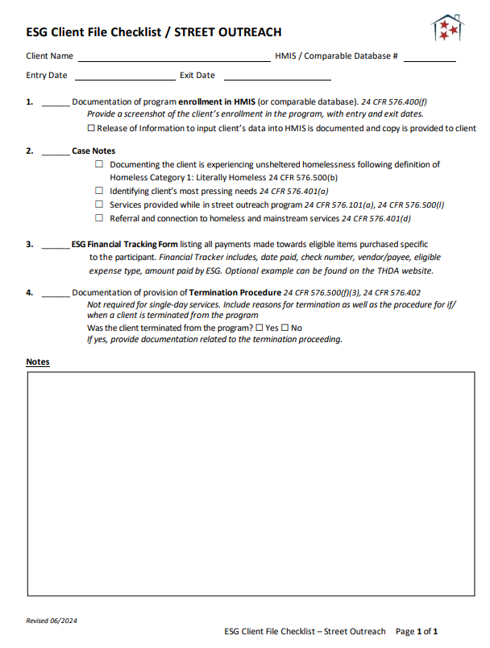
Street Outreach Client File Checklist

Slide 22
1.
Enrollment into HMIS
Check HMIS or comparable database to determine if the applicant is currently receiving assistance from any other federal funding sources.
Clients cannot receive funding for duplicate services at the same time.
In client’s file, include a printed HMIS screenshot can be used as documentation in the applicant’s file to show enrollment into HMIS or comparable database

Slide 23
2.
Case Notes
Outreach teams will be responsible for ensuring that a case plan is established for each household that is client-centered, realistic, and focused towards a goal of permanent housing.
Case notes should document:
  Client is experiencing unsheltered homelessness
  The immediate needs of client
  All services provided to client under SO activity
  Referral and connection to other mainstream resources and other homeless service providers as necessary

Slide 24
3.
Financial Assistance Tracking
Costs tracked in client files are only for expenses for specific clients
Bulk purchases of tents or outreach kits do not need to be tracked in financial tracking but must be recorded in case notes under services provided
Financial Tracking Sheet is on the ESG website that can be used as an optional way to track individual client purchases

Slide 25
4. Termination Procedure
24 CFR 576.402(a) - If a program participant violates program requirements, the recipient or subrecipient may terminate the assistance in accordance with a formal process established by the agency that recognizes the rights of individuals affected. The agency must exercise judgment and examine all extenuating circumstances in determining when violations warrant termination so that a program participant's assistance is terminated only in the most severe cases.
For ESG Street Outreach and Emergency Shelter, the ESG Interim Rule does not require that any specific criteria cited be included in the termination policy.
If a client is terminated from your Street Outreach program, detailed case notes must be included outlining the circumstances.

Slide 26
What are ESG Written Standards?
Standard Policies and Procedures for your ESG program, must also align with CoC Written Standards
Each ESG program component has differing minimum standards that need to be included
The ESG Written Standards Checklist outlines each requirement per program component
Must be followed consistently throughout the grant year and with each client that you serve
ESG Written Standards are required to be sent in with each agency’s ESG application and are reviewed by THDA – changes may be necessary
Any changes made to your Policies and Procedures must have Board approval and a Board Resolution of those approved Policies and Procedures must be documented
If you would like assistance drafting written standards that meet minimum requirements, do not hesitate to reach out to our team

Slide 27
Written Standards for Street Outreach
Standards include the area of service where assistance is to be offered.
Standards include all type(s) of assistance that will be offered through the ESG program. Describe all ESG program components, essential services and eligible costs your agency will provide with ESG. *
Standards shall include HUD definitions of homeless and at-risk of homelessness, as defined in 24 CFR 576.2.
Standards summarize the procedure in place that defines how program participants will be evaluated for eligibility of assistance under the ESG program.*
Standards include procedures describing the coordination with other targeted homeless programs and mainstream services. Explain participation in Coordinated Entry. *
Standards describe the formal termination process established by the agency that recognizes the rights of individuals affected.*
Standards include steps used to ensure compliance with HMIS.*
Standards for targeting and providing essential services related to street outreach.
*Refer to ESG Written Standards Checklist for more detail of these Written Standard requirements.

Slide 28
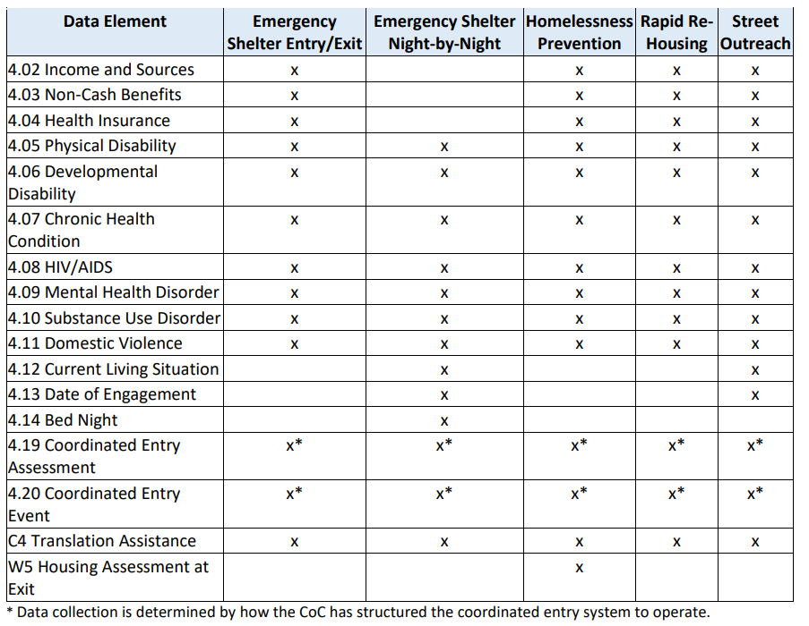
Reporting Requirements
The annual ESG CSV-CAPER report is required for all grantees to submit to THDA at the end of each grant year.
The following data for each component needs to be collected throughout the year.
Review the ESG Program HMIS Manual & coordinate with your CoC for more detailed strategies for the use of the HMIS for ESG.

Slide 29
Julie Ridenour
SENIOR HOUSING PROGRAMS COMPLIANCE COORDINATOR

Slide 30
STREET OUTREACH
OBSERVED FINDINGS & CONCERNS
Documentation of how “Homelessness” is determined
Documentation of program enrollment in HMIS (or comparable database).
All Street Outreach costs have supporting documentation outlining date of transaction, invoice, copy of check or receipt [24 CFR 576.500(u)]

Slide 31
DOCUMENTATION OF HOW HOMELESSNESS IS DETERMINED
  24 CFR 576.500(b)
  Homeless status. The recipient must maintain and follow written intake procedures to ensure compliance with the homeless definition in § 576.2. The procedures must require documentation of the evidence relied upon to establish and verify homeless status. The procedures must establish the order of priority for obtaining evidence as third-party documentation first, intake worker observations second, and certification from the person seeking assistance third.
  Records contained in an HMIS or comparable database used by victim service or legal service providers are acceptable evidence of third-party documentation and intake worker observations if the HMIS retains an auditable history of all entries, including the person who entered the data, the date of entry, and the change made; and if the HMIS prevents overrides or changes of the dates on which entries are made.

Slide 32
  24 CFR 500(B)(1)
  If the individual or family qualifies as homeless under paragraph (1)(i) or (ii) of the homeless definition in § 576.2, acceptable evidence includes a written observation by an outreach worker of the conditions where the individual or family was living, a written referral by another housing or service provider, or a certification by the individual or head of household seeking assistance.
  RECOMMENDATION:
  ESG VERIFICATION OF HOMELESS STATUS FORM
  https://thda.org/documents/1.-ESG-Verification-of-Homeless-Status.pdf

Slide 33
DOCUMENTATION OF PROGRAM ENROLLMENT IN HMIS (or comparable database)
24 CFR 576.500(n) The recipient must keep records of the participation in HMIS or a comparable database by all projects of the recipient and it’s subrecipients.
RECOMMENDATION:
Screen shot of the HMIS main screen

Slide 34
OUTREACH COSTS MUST HAVE SUPPORTING DOCUMENTATION
24 CFR 576.500(u)
Financial records
(1) The recipient must retain supporting documentation for all costs charged to the ESG grant.
(2) The recipient and its subrecipients must keep documentation showing that ESG grant funds were spent on allowable costs in accordance with the requirements for eligible activities under
“§§ 576.101 through 576.109, financial management in
2 CFR 200.302, and the cost principles in 2 CFR part 200, subpart E.

Slide 35
QUESTIONS?

Slide 36


How can a record from HMIS or a comparable database count as documentation of homelessness?
A single record of a stay in an emergency shelter or a safe haven or an outreach contact of an individual or head of household residing in a place not meant for human habitation in a single month is sufficient documentation to consider the individual or head of household as residing in that location for the entire month unless there is clear evidence of a break such as an HMIS record of an exit to permanent housing. Where data is available, the intake worker could document the individual or head of household’s entire period of homelessness based on records contained in HMIS or a comparable database. It should be noted that self-reported data contained in HMIS or a comparable database does not qualify as third-party documentation.
How can a record from HMIS or a comparable database count as documentation - HUD Exchange

Slide 37
What if a client declines permission of entry into HMIS?
Data will still need to be entered for each client but unique identifiers can be used in place of the client’s name. For example, you would record a date “4.5.2023” and a deidentified name “Redhat Tenthstreetbridge” that would be identifiable for retrieval by the street outreach project in HMIS. However, Street Outreach projects are prohibited from establishing protocols that only require outreach workers to collect minimal client data. Over time, street outreach projects must attempt to collect all data required and edit recorded data for accuracy (e.g., replacing “Redhat” with “Robert”) as the client relationship evolves.
Work with your local CoC to prevent duplication of client records and obtain proper data quality.
See “ESG Program HMIS Manual” for more information about Street Outreach Data Challenges and De-Duplication of Client Records under Street Outreach.

Slide 38
Can the records for ESG be retained in an electronic format or must hard copy records be retained?
Documentation of each program participant's qualification as homeless or at risk of homelessness and other program participant records must be retained in accordance with the requirements at 24 CFR part 576.500(y). Recipients/subrecipients may store files electronically, but must be able to produce records in hard copy upon request, or allow them to be viewed as part of an on-site or remote monitoring or audits conducted by designated federal agency staff or by the HUD Office of Inspector General. Additionally, if the recipient/subrecipient uses an electronic system, it must maintain an adequate back-up system for the files, and must ensure that privacy protections are established and followed that adhere to other federal privacy regulations, such as HIPAA (Health Insurance Portability & Accountability Act).
The OMB OmniCircular, at 2 CFR part 200.335, encourages the use of electronic recordkeeping whenever practicable.
Can the records for ESG be retained in an electronic format or must hard co - HUD Exchange

Slide 39
Contact Information
  Jodi Smith
  Housing Program Manager
  (615) 815-2038
  jsmith@thda.org
  Cheri Ballinger
  Housing Program Coordinator
  (615) 815-2041
  cballinger@thda.org
  To reach our entire team –
  ESG@thda.org
  Brianna Atol
  Senior Housing
  Program Coordinator
  (615) 815-2216
  batol@thda.org

Slide 40
Compliance and Asset Management (CAM) Team
Heather Reynolds
Director of Compliance and Asset Management
(615) 815-2149
Tanya Jackson
Housing Programs Compliance Manager
(615) 815-2039
Julie Ridenour
Senior Housing Programs Compliance Coordinator
(615) 815-2196
HReynolds@thda.org
TJackson@thda.org
JRidenour@thda.org
  To reach our entire team –
  CPCompliance@thda.org

Slide 41
Additional Resources
  HUD Exchange
  https://www.hudexchange.info/programs/esg/
  Code of Federal Regulations (24 CFR 576)
  https://www.ecfr.gov/current/title-24/subtitle-B/chapter-V/subchapter-C/part-576
  HUD Exchange Unsheltered Homelessness
  https://www.hudexchange.info/homelessness-assistance/unsheltered-homelessness/
  Housing First Implementation Resources
  https://www.hudexchange.info/programs/coc/toolkit/responsibilities-and-duties/housing-first-implementation-resources/#housing-first-implementation
  THDA’s ESG Program Guide
  https://thda.org/pdf/1.-ESG-Guide.pdf
  Recording and Documenting Homeless Status
  https://www.hudexchange.info/trainings/courses/recording-and-documenting-homeless-status/
  Closing the Gap: Homelessness to Housing Webinar Series – Street Outreach
  https://files.hudexchange.info/resources/documents/Closing-the-Gap-Homelessness-to-Housing-Street-Outreach-Slides.pdf
  Effectively equipping law enforcement to work with people experiencing homelessness
  https://bja.ojp.gov/program/pmhc/responding-homelessness

