Slide 1

Understanding ESG’s Emergency Shelter Component
TN Housing Development Agency - September 2024

Slide 2
Emergency Shelter Definition
Emergency shelter means any facility, the primary purpose of which is to provide a temporary shelter for the homeless in general or for specific populations of the homeless and which does not require occupants to sign leases or occupancy agreements.
Both day shelters and overnight shelters are considered Emergency Shelter under ESG.

Slide 3
Minimum Period of Use
Where ESG funds are used solely for essential services or shelter operations under the Emergency Shelter component, services or shelter must be provided to homeless individuals and families at least for the period during which the ESG funds are provided (§ 576.102(c)(2)).
In the case of a seasonal shelter, this could be based on the contract period specified in the subrecipient agreement.

Slide 4
Low-Barrier Shelter
THDA-funded emergency shelter projects should have low barriers to entry and participation. Low barrier means removing all obstacles that prevent entry. Here are common barriers and alternative low barrier.
Low barrier doesn’t mean low standards
Sobriety
vs.
Providing shelter to those under the influence who do not pose a threat
Rigid rules and requirements
vs.
granting autonomy when it doesn’t pose a threat to others
Strict curfews
vs.
allowing exceptions when deemed practical
Mandatory program participation
vs.
shelter provided with no exceptions
Background checks, criminal records
vs.
admission of all if it doesn’t impede on the safety of others
Must have a job or income
vs.
allowing entry then using case management and supportive services to help the client gain income and housing

Slide 5

Rights and Obligations Under Federal Law
The Fair Housing Act
Section 504
American Disabilities Act

Slide 6



The Fair Housing Act
Protects from discrimination when renting or buying a home, getting a mortgage, seeking housing assistance or engaging in other housing related activities.
Protected classes: Race, colors, national origin, religion, sex (including gender identity and sexual orientation), familial status and disability.
Types of housing covered includes but is not limited to single-family homes, apartments, condominiums, mobile homes, dormitories, and many shelters. Applies to both public and private housing.

Slide 7
Section 504 and American Disabilities Act
Section 504
“Reasonable accommodations“
Reasonable accommodations applies to any changes that may be necessary to provide equal opportunity to participate in any federally-assisted program or activity.
This includes a change, adaptation or modification to a policy, program, service, facility, or workplace which will allow a qualified person with a disability to participate fully in a program, take advantage of a service, live in housing, or perform a job.
ADA
Similar to and based upon the Section 504 reasonable accommodation requirement, Titles II and III of the ADA require public entities and public accommodations to make reasonable modifications to policies, practices, or procedures to avoid discrimination.
More Information about Reasonable Accommodations and Modifications: https://www.hud.gov/program_offices/fair_housing_equal_opp/reasonable_accommodations_and_modifications

Slide 8
Equal Access to Housing Final Rule
The Equal Access Rule creates a new regulatory provision that generally prohibits considering a person’s marital status, sexual orientation, or gender identity in making eligibility determinations for housing. It applies to all McKinney-Vento funded housing programs, including ESG.
It defines a Family as applicable to the ESG program, as follows:
Family includes, but is not limited to, regardless of marital status, actual or perceived sexual orientation, or gender identity, any group of persons presenting for assistance together with or without children and irrespective of age, relationship, or whether or not a member of the household has a disability. A child who is temporarily away from the home because of placement in foster care is considered a member of the family.
What this means is that any group of people that present together for assistance and identify themselves as a family, regardless of age or relationship or other factors, are to be considered a family and must be served together as such.

Slide 9

Prohibition of Family Separation
HUD regulations state that all shelters serving families with children under 18 are prohibited from denying access to families based on the age of a child under 18.
This requirement has been issued through the Equal Access Rule as well as the HEARTH Act and the ESG Interim Rule.
All THDA-funded emergency shelters will comply with this requirement. Non-compliance may result in removal of ESG funds.

Slide 10
Equal Access in Accordance with Gender Identity: 2016 Amended Equal Access Rule
CPD- funded programs, including shelters, MUST:
Provide equal access to CPD programs, shelter, services, etc. to individuals according to their gender identity, and in a manner that affords equal access to their family.
Place, serve, and accommodate individuals according to their self-identified gender identity;
Not ask intrusive questions or require “proof” of gender identity;
Determine eligibility without regard to actual or perceived sexual orientation, gender identity, or marital status; and
Establish or update policies and procedures to reflect the above.
See CFR 5.106 (b)
All THDA ESG grantees must comply with requirements of the Equal Access to Housing Final Rule, the Equal Access in Accordance with Gender Identity Final Rule, and any applicable guidance, regardless of whether or not the ESG grantee is a victim service or faith-based provider. Non-compliance may result in termination of ESG funding.

Slide 11
What does this mean for placing a non-binary individual in a project?
Non-binary individuals are permitted to choose the most appropriate gender-based placement in situations when gender neutral options are not available.
Allow non-binary individuals to choose the most appropriate gender-based sleeping and bathing accommodations in a facility.
Note pronouns in files and when introducing the individual.
Inform the individual that they can request a privacy accommodation.
Collaborate and ask them what they want.
BEST PRACTICE – ask everyone their pronouns

Slide 12
Language Access Plan
Consistent with Title VI and Executive Order 13166, grantees are also required to take reasonable steps to ensure meaningful access to programs and activities for Limited English Proficiency (LEP) persons. An individual’s ability to speak, read, write, or understand English cannot impede his or her access to programs or activities.
The grantee must assess the need for language assistance within its service area by conducting a Four Factor Analysis to understand the languages spoken by LEP persons and how to provide needed language assistance. The Four Factor Analysis must consider:
The number or proportion of LEP persons served or encountered in the eligible service population
The frequency with which LEP persons come into contact with the program
The nature and importance of the program, activity, or service
The resources available to execute the program and costs of providing LEP services

Slide 13
Language Access Plan
Based on the Four Factor Analysis, the grantee must prepare a Language Access Plan (LAP) to include:
The name of the individual responsible for coordination of LEP compliance;
A training plan on LEP requirements for all staff involved in programs and activities funded;
The languages identified;
A plan for language services based on language assistance needs identified;
A schedule for translating and disseminating vital documents; and
A policy for updating the Four Factor Analysis and LAP.

Slide 14
Faith-Based Activities
Organizations that are directly funded under the ESG Program may not engage in inherently religious activities, such as worship, religious instruction, or proselytization as part of the programs or services funded under ESG.
If an organization conducts these activities, the activities must be offered separately, in time or location, from the programs or services funded under ESG, and participation must be voluntary for program participants.
An organization that receives ESG funds shall not, in providing ESG assistance, discriminate against a program participant or prospective program participant on the basis of religion or religious belief.

Slide 15
Coordinated Entry Participation
All ESG Emergency Shelter grantees must participate in the coordinated assessment system developed by the Continuum of Care (“CoC”) in which services are delivered.
This system should include all homeless subpopulations and involve the use of a standardized assessment tool that will result in referrals to those seeking assistance based upon a uniform decision-making process.
The system should ensure that those with the greatest needs receive priority for housing and service provision and that no unnecessary barriers exist for individuals to receive assistance.

Slide 16
Environmental Review
All THDA ESG projects must receive an approved environmental review from THDA, pursuant to 24 CFR part 58, before any ESG funds may be committed.
After awards are announced and prior to the contract start date, THDA will send each grantee an Environmental Review Questionnaire. This questionnaire helps us accurately determine the level of review needed.
THDA completes this review on behalf of the grantees.

Slide 17
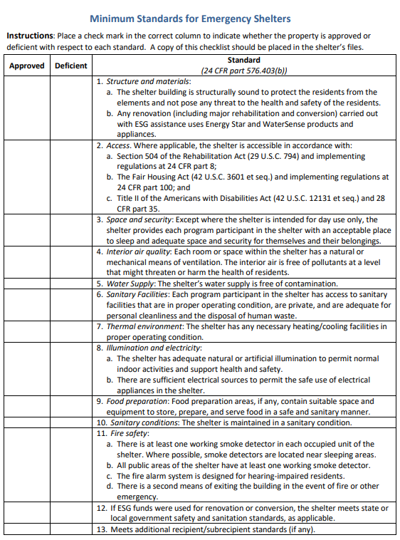
Shelter Habitability Standards
Emergency shelters that receive ESG funds for shelter operations must meet the minimum standards for safety, sanitation, and privacy provided in §576.403(b).
ESG Minimum Habitability Standards for Emergency Shelters and Permanent Housing: Checklists can be found - HERE
Notes:
Structurally Sound,
ADA accessible,
that there is space for them and their belongings,
good air quality,
the water is free of contaminants,
there is heating and air conditioning,
adequate lighting and good electricity for safe use of appliances,
suitable space to store, prepare and serve food in a safe sanitary manner,
sanitary conditions overall,
fire safety- smoke detectors in sleeping areas and public areas, fire alarm for hearing impaired and a 2nd exit in case of fire.

Slide 18
Lead-Based Paint Protection Lead Safe Housing Rules Toolkit: Introduction - HUD Exchange
Emergency shelters who do not fall under the definition of zero-bedroom dwellings, must comply with the comply with:
Lead-Based Paint Poisoning Prevention Act (42 U.S.C. 4821–4846),
Residential Lead-Based Paint Hazard Reduction Act of 1992 (42 U.S.C. 4851–4856),
implementing regulations in Lead Safe Housing Rule (LSHR) 24 CFR part 35, subparts A, B, H, J, K, M, and R. (Specifically, subpart K)
The LSHR does not apply if housing meets one of these conditions:
Property constructed on or after January 1, 1978
Zero-bedroom and Single-Room Occupancy units*
Housing for the elderly, or a residential property designated exclusively for persons with disabilities*
Properties found to be LBP free by an inspection, or where all LBP has been identified, removed, and clearance achieved
An unoccupied property that is to be demolished and remains unoccupied until demolition
Emergency repairs to protect life, health, safety or structure
Rehabilitation that does not disturb a painted surface
Compliance with requirements for testing and remediation may be reasonably delayed due to adverse weather conditions

Slide 19
Lead-Based Paint Protection 1. Prepare
Owners and administrators must create and maintain records to document compliance of Lead-Based Paint safety. Complete and retain records of the following:
If the shelter is not exempt, the basic approach is to carry out proper communication with new and existing tenants and to assure units are inspected, any deteriorated paint is stabilized, and, if the assistance is ongoing, maintain those units.
LSHR Toolkit: Screening for Exemption or Limited Exemptions (hudexchange.info)
Complete and retain for all assisted units to determine if they are partially or fully exempt

Slide 20
Lead-Based Paint Protection 2. Communicate with Tenants
If a shelter unit is not exempt, the owner must provide a pamphlet, a disclosure form and disclose all known information about LBP, LBP hazards, and mitigation steps; the following forms must be given to shelter clients:
Protect Your Family from Lead in Your Home (English) | US EPA (available in multiple languages)
Lessor's Disclosure of Information on Lead-Based Paint and/or Lead-Based Paint Hazards | US EPA (English, also available in Spanish)
LSHR Toolkit: Special Needs Housing Programs and the LSHR (hudexchange.info)
Ensures tenants are aware of lead safety. The tenant who signs the lease/rental agreement should receive this pamphlet and it should be retained with a signed copy of the disclosure form in the tenant file (property owner keeps original).
Provides disclosure form to tenants to show lead hazard activities undertaken. This is given by the owners/landlords. Owners use the form to disclose all known information, including no knowledge, of the presence of LBP and hazard reduction work and tenants must acknowledge receipt of the owner’s information.
Provides information on how the LSHR applies to special needs housing programs such as Housing Opportunities for Persons With Aids (HOPWA) and Emergency Solutions Grants (ESG).

Slide 21
Lead-Based Paint Protection 3. Initial Assessment & On-Going Assessments
Shelters who are not exempt, must complete initial Visual Assessments for deteriorated paint, paint stabilized, and clearance achieved before opening.
Shelters who remain open should complete annual assessments as well. Owners of the property must have and implement an ongoing lead paint maintenance plan.
LSHR Toolkit: Annual Visual Assessments & Findings Resolution Log (hudexchange.info)
Records when the inspector, trained in visual assessment techniques, performed the Visual Assessment and documents the location, how much (area) deteriorated paint was found, and owner's responsibility to treat and clear the hazards.
Sample Certification for Ongoing Monitoring and Maintenance – Visual Assessment (Word doc)
Certifies ongoing maintenance requirements are met when only visual assessment is needed for evaluation.

Slide 22
Lead-Based Paint Protection 4. Repair Work & On-going Maintenance
For all work that disturbs paint above the HUD LSHR de minimis level, the work must meet certain HUD and Environmental Protection Act (EPA) requirements, including paint testing or the presumption of lead. If lead is present or presumed, then lead safe work practices and worker/occupant protection procedures must be implemented and documented. View the Hazard Reduction Module for more information on these procedures.
If small repair meets the HUD standard for de minimis, complete the following. A unit can only be fully exempt if no paint will be disturbed.
When repair work and ongoing maintenance is complete, clearance must be completed. Watch the Clearance Examination Highlights video to learn the basics of how to complete a clearance examination.
Additional EPA Requirements- The EPA requires that all work disturbing paint in pre-1978 residential properties above the Renovation, Repair, and Painting (RRP) rule de minimis level (different from HUD LSHR) follow certain requirements, similar to, but separate from the LSHR requirements. See the Guidance on Reconciliation of RRP and LSHR for more information.
Part 2 of the LSHR Screening on Exemption or Limited Exemption
Determines if there is a one-time small repair exemption for some requirements.

Slide 23
Eligible Participants
All categories of Homelessness are eligible under Emergency Shelter
Category 1 –
Literally Homeless
Category 2 –
Imminent Risk of Homelessness
Category 3 –
Homeless under other Federal Statutes
Category 4 –
Fleeing or Attempting to Flee DV

Slide 24
Category 1 – Literally Homeless
Individual or family who lacks a fixed, regular, and adequate nighttime residence, meaning:
Has a primary nighttime residence that is a public or private place not meant for human habitation;
Is living in a publicly or privately operated shelter designated to provide temporary living arrangements (including congregate shelters, transitional housing, and hotels and motels paid for by charitable organizations or by federal, state, and local government programs); or
Is exiting an institution where (s)he has resided for 90 days or less and who resided in an emergency shelter or place not meant for human habitation immediately before entering that institution

Slide 25
Category 2 – Imminent Risk of Homelessness
Individual or family who will imminently lose their primary nighttime residence, provided that:
Residence will be lost within 14 days of the date of application for homeless assistance;
No subsequent residence has been identified; and
The individual or family lacks the resources or support networks needed to obtain permanent housing
Note: this category differs from the At-Risk of Homelessness definition due to having no income requirement & less supporting documentation needed to enter the emergency shelter.

Slide 26
Category 3 – Homeless under other Federal Statutes
Unaccompanied youth under 25 years of age, or families with children and youth, who do not otherwise qualify as homeless under this definition, but who:
Are defined as homeless under the other listed federal statutes (explained on next slide);
Have not had a lease, ownership interest, or occupancy agreement in permanent housing during the 60 days prior to the homeless assistance application;
Have experienced persistent instability as measured by two moves or more during the preceding 60 days; and
Can be expected to continue in such status for an extended period of time due to special needs or barriers

Slide 27
Category 3 - Other Federal Statutes cont.
For the purposes of this definition, other federal statutes for defining homelessness include:
• Section 387 of the Runaway and Homeless Youth Act (42 U.S.C. 5732a)
• Section 637 of the Head Start Act (42 U.S.C. 9832)
• Section 41403 of the Violence Against Women Act of 1994 (42 U.S.C. 14043e–2)
• Section 330(h) of the Public Health Service Act (42 U.S.C. 254b(h)
• Section 3 of the Food and Nutrition Act of 2008 (7 U.S.C. 2012)
• Section 17(b) of the Child Nutrition Act of 1966 (42 U.S.C. 1786(b) OR
• Section 725 of the McKinney-Vento Homeless Assistance Act (42 U.S.C.11434a)

Slide 28
Category 4 – Fleeing or Attempting to Flee DV
Any individual or family who:
Is fleeing, or is attempting to flee, domestic violence, dating violence, sexual assault, stalking, or other dangerous or life-threatening conditions that relate to violence against the individual or a family member, including a child, that has either taken place within the individual's or family's primary nighttime residence or has made the individual or family afraid to return to their primary nighttime residence
Has no other residence; and
Lacks the resources or support networks, e.g., family, friends, faith-based or other social networks, to obtain other permanent housing

Slide 29
Chronic Homelessness Definition
2) An individual who has been residing in an institutional care facility, including jail, substance abuse or mental health treatment facility, hospital, or other similar facility, for fewer than 90 days and met all of the criteria of #1 before entering that facility; or
3) A family with an adult head of household (or if there is no adult in the family, a minor head of household) who meets either of the criteria of #1 or #2, including a family whose composition has fluctuated while the head of household has been homeless.
1) Lives in a place not meant for human habitation, a safe haven, or in an emergency shelter; AND Has been homeless and living as described above continuously for at least 12 months or on at least 4 separate occasions in the last 3 years, as long as the combined occasions equal at least 12 months and each break in homelessness separating the occasions included at least 7 consecutive nights of not living as described above. Stays in institutional care facilities for fewer than 90 days will not constitute as a break in homelessness; but rather, such stays are included in the 12-month total, as long as the individual was living or residing in a place not meant for human habitation, a safe haven, or an emergency shelter immediately before entering the institutional care facility; or
A “homeless individual with a disability”, as defined in section 401(9) of the McKinney-Vento Assistance Act (42 U.S.C. 11360(9)), who:

Slide 30
Eligible Activities
Essential Services
Case Management
Mental Health Services
Child Care
Education Services
Employment assistance & job training
Outpatient Health Services
Legal Services
Life Skills training
Transportation
Services for Special Populations
Substance Abuse Treatment Services
Shelter Operations
Rent for shelter space
Security
Fuel
Insurance
Utilities
Food
Furnishings
Essential supplies
Hotel/Motel vouchers

Slide 31
Case Management
Assessing housing and service needs, and arranging, coordinating, and monitoring the delivery of individualized services.
Using the Coordinated Entry system
Conducting evaluations
Verifying eligibility
Counseling
Developing, securing and coordinating services
Obtaining Federal, State and local benefits
Monitoring & evaluating client’s progress
Connecting clients with other referrals
Ongoing risk assessment & safety planning with victims of domestic violence, dating violence, sexual assault, and stalking
Developing housing plan towards permanent housing stability

Slide 32
Employee Compensation
Employee compensation (including fringe benefits such as holiday, vacation, sick leave) must be reimbursed for actual hours worked under street outreach and should be tracked
Timesheets that capture actual time spent on specific programs are the most straightforward way to meet time reporting requirements. However, other approaches may be acceptable as long as they meet the guidelines established in Circular A-87 Appendix B(8)(H) for States or units of local government or Circular A-122 Appendix B(8)(m) for nonprofit organizations, or the OMB OmniCircular, at 2 CFR part 200, as applicable.
A staff position that is not fully dedicated to ESG cannot be paid solely through ESG funds
Are employee compensation (including fringe benefits such as holiday, vacation, sick leave) and other overhead costs eligible expenses under the ESG program? How should these costs be allocated?

Slide 33
Child Care
The costs of child care for program participants, including providing meals and snacks, and comprehensive and coordinated sets of appropriate developmental activities, are eligible. The children must be under the age of 13, unless they are disabled. Disabled children must be under the age of 18. The child-care center must be licensed by the jurisdiction in which it operates in order for its costs to be eligible.

Slide 34
Education Services
When necessary for the program participant to obtain and maintain housing, the costs of improving knowledge and basic educational skills are eligible. Services include instruction or training in consumer education, health education, substance abuse prevention, literacy, English as a Second Language, and General Educational Development (GED). Component services or activities are screening, assessment, and testing; individual or group instruction; tutoring; provision of books, supplies and instructional material; counseling; and referral to community resources.

Slide 35
Employment Assistance & Job Training
The costs of employment assistance and job training programs are eligible, including classroom, online, and/or computer instruction; on-the-job instruction; and services that assist individuals in securing employment, acquiring learning skills, and/or increasing earning potential. Learning skills include those skills that can be used to secure and retain a job. Services that assist individuals in securing employment consist of employment screening, assessment, or testing; structured job skills and job-seeking skills; special training and tutoring, including literacy training and pre-vocational training; books and instructional material; counseling or job coaching; and referral to community resources.

Slide 36
Outpatient Health Services
Eligible costs are for the direct outpatient treatment of medical conditions and are provided by licensed medical professionals. Funds may be used only for these services to the extent that other appropriate health services are unavailable within the community.
Assessing a client’s health problems
Developing a treatment plan
Prescriptions and follow-up services
Preventative medical care
Preventative and non-cosmetic dental care

Slide 37
Legal Services
Eligible costs are the hourly fees for legal advice and representation by attorneys licensed and in good standing with the bar association of the State in which the services are provided, and by person(s) under the supervision of the licensed attorney, regarding matters that interfere with the program participant’s ability to obtain and retain housing.
ESG funds may be used only for these services to the extent that other appropriate legal services are unavailable or inaccessible within the community.
Eligible subject matters are child support, guardianship, paternity, emancipation, and legal separation, orders of protection and other civil remedies for victims of domestic violence, dating violence, sexual assault, and stalking, and appeal of veterans and public benefit claim denials.
Component services or activities may include client intake, preparation of cases for trial, provision of legal advice, representation at hearings, and counseling.
Fees based on the actual service performed (i.e., fee for service) are also eligible, but only if the cost would be less than the cost of hourly fees. Filing fees and other necessary court costs are also eligible. If the grantee is a legal services provider and performs the services itself, the eligible costs are the grantee’s employees’ salaries and other costs necessary to perform the services.

Slide 38
Life Skills Training
The costs of teaching critical life management skills that may never have been learned or have been lost during the course of physical or mental illness, domestic violence, substance use, and homelessness are eligible costs. These services must be necessary to assist the program participant to function independently in the community.
Component life skills training are budgeting resources, managing money, managing a household, resolving conflict, shopping for food and needed items, improving nutrition, using public transportation, and parenting.

Slide 39
Mental Health Services
Outpatient treatment of urgent mental health conditions by licensed professionals in community-based settings (e.g., streets, parks, and campgrounds and other places unsheltered people are living). These services are eligible only to the extent that other appropriate mental health services are inaccessible or unavailable within the area.
Mental health services are the application of therapeutic processes to personal, family, situational, or occupational problems to bring about positive resolution of the problem or improved individual or family functioning or circumstances.
Health services delivered in a non-facility setting, rather than services that may be delivered on a routine basis.
Crisis Intervention
Prescriptions
Explanation about the use and management of medications and combinations of therapeutic approaches

Slide 40
Substance Abuse Treatment Services
Eligible substance abuse treatment services are designed to prevent, reduce, eliminate, or deter relapse of substance abuse or addictive behaviors and are provided by licensed or certified professionals.
ESG funds may only be used for these services to the extent that other appropriate substance abuse treatment services are unavailable or inaccessible within the community.
Eligible treatment consists of client intake and assessment and outpatient treatment for up to 30 days.
Group and individual counseling and drug testing are eligible costs.

Slide 41
Transportation
Travel by outreach workers, social workers, medical professionals, or other service providers during the provision of eligible street outreach services. Also includes the costs of transporting unsheltered people to emergency shelters or other service facilities.
Client’s travel on public transportation
When public transportation is not available, Lyft & Ubers can be used. Reasonable tips for drivers are a reimbursable expense
Service worker’s mileage when using their own vehicle to transport clients
Cost of gas, insurance, and maintenance on a vehicle used to transport Emergency Shelter clients
Travel costs of service workers to accompany or assist clients to use public transportation

Slide 42
Services for Special Populations
Emergency Shelter services that have been tailored to address the special needs of homeless youth, victims of domestic violence and related crimes or threats, and people living with HIV/AIDS

Slide 43
Shelter Operations
Eligible costs are the costs of maintenance (including minor or routine repairs), rent, security, fuel, equipment, insurance, utilities, food, furnishings, and supplies necessary for the operation of the emergency shelter.
Where no appropriate emergency shelter is available for a homeless family or individual, eligible costs may also include a hotel or motel voucher for that family or individual.
The approval of shelter rent must be pre-approved by THDA in the Environmental Review process.
If agency receives multiple shelter grants, shelter operations must be split between those grants when submitting THDA reimbursement.

Slide 44
Ineligible Costs Under Emergency Shelter
THDA does not allow for major rehabilitation or conversion of emergency shelters
Shelter rent that was not approved by THDA in the Environmental Review process
Legal services for immigration and citizenship matters and issues relating to mortgages are ineligible costs. Retainer fee arrangements and contingency fee arrangements
Inpatient detoxification and other inpatient drug or alcohol treatment

Slide 45
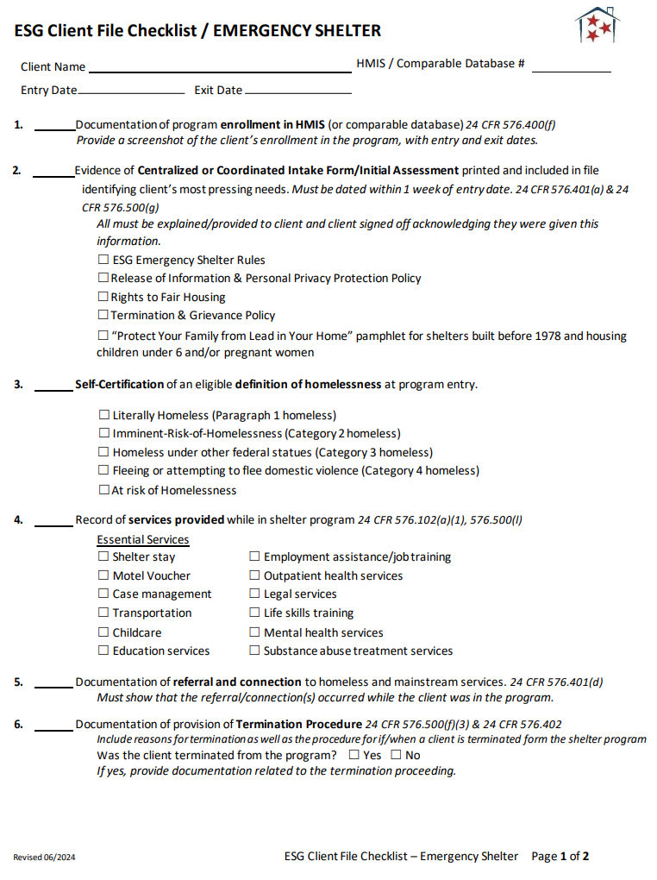
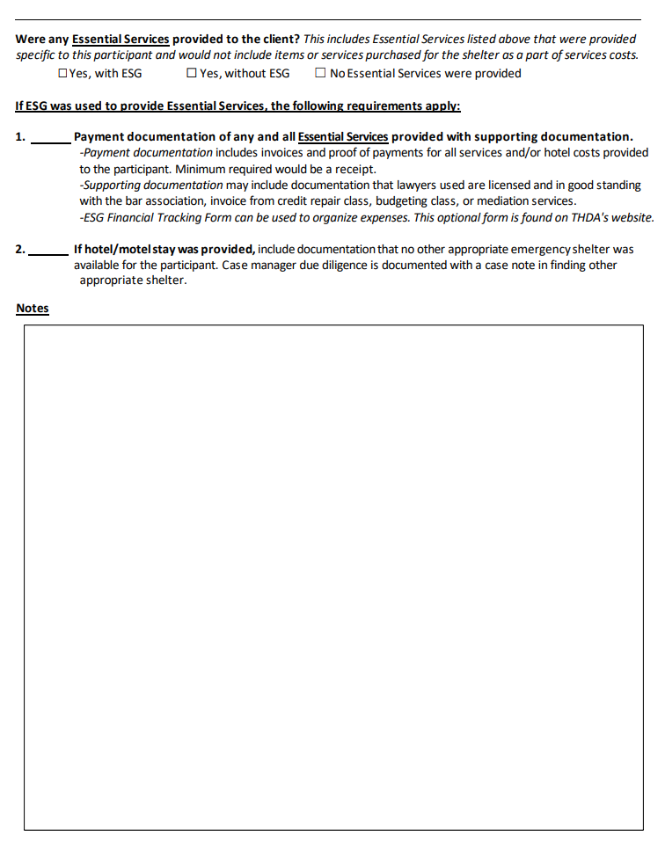
Emergency Shelter Client File Checklist

Slide 46
1. Enrollment into HMIS
A HMIS screenshot can be used as documentation in the applicant’s file to show enrollment into HMIS or comparable database
For shelter staff-
Clients cannot receive funding for duplicate services at the same time.
Check HMIS or comparable database to determine if the client is currently receiving assistance from any other federal funding sources
Notes:
All persons accessing shelter must be entered into Coordinated Entry HMIS system

Slide 47
2. Centralized Intake Form or Initial Assessment
Agency must keep documentation evidencing the use of the centralized or coordinated assessment system(s) developed by the Continuum of Care(s) in accordance with the requirements established by HUD
The best way to show this would be including the CoC developed coordinated assessment in the client’s ESG file
All must be explained or provided to client and client signed off acknowledging they were given this information.
ESG Emergency Shelter Rules
Release of Information & Personal Privacy Protection Policy
Rights to Fair Housing
Termination & Grievance Policy
“Protect Your Family from Lead in Your Home” pamphlet for shelters built before 1978 and housing children under 6 and/or pregnant women
Notes:
All grantees must participate in the coordinated entry system developed by their CoC
If one agency has one shelter in one CoC in another shelter in a different CoC, the agency must comply with CoC coordinated entry for each specific location that the shelter is in.

Slide 48
3. Certifying Homelessness Status
Emergency Shelter may rely on self-certification of homelessness from the head of household as the primary method of establishing homelessness status
Examples-
Self-certification from client that they are homeless
HMIS or HMIS Comparable Database screen shot that shows a client already enrolled in a program for persons experiencing homelessness
Lack of third-party documentation must not prevent an individual or family from being immediately admitted to emergency shelter or receiving services provided by a victim service provider.
Notes:
Could be a sign-in sheet at the shelter certifying this

Slide 49
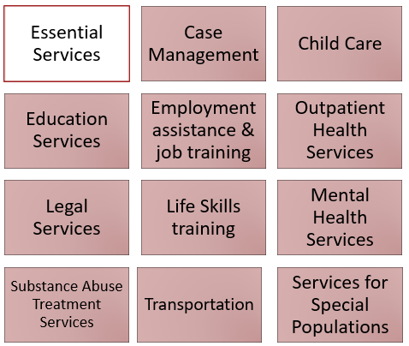

4. Record of Services Provided
All eligible Emergency Shelter Essential Services provided on an individual basis should be tracked in the client’s file:
Case notes are a recommended option to satisfy this client file requirement.
Any financial assistance supporting documentation should also be collected and inserted in the client’s chart as a part of #7 of the Emergency Shelter Client File Checklist.

Slide 50
5. Referral & Connection
THDA grantees are expected to provide case management to all ESG program participants, including connecting program participants to mainstream and other resources. Grantees should assist each program participant, as needed, to obtain:
Appropriate supportive services, including assistance in obtaining permanent housing, medical health treatment, mental health treatment, counseling, supervision, and other services essential for achieving independent living; AND
Other Federal, State, local, and private assistance available to assist the program participant in obtaining housing stability, including:
Medicaid (42 CFR chapter IV, subchapter C)
Supplemental Nutrition Assistance Program (7 CFR parts 271– 283);
Women, Infants and Children (WIC) (7 CFR part 246);
Federal-State Unemployment Insurance Program (20 CFR parts 601– 603, 606, 609, 614–617, 625, 640, 650);
Social Security Disability Insurance (SSDI) (20 CFR part 404);
Supplemental Security Income (SSI) (20 CFR part 416);
Child and Adult Care Food Program (42 U.S.C. 1766(t) (7 CFR part 226));
Other assistance available under the programs listed in § 576.400(c).
Referrals & Connections can be tracked using the Referral Tracking Tool found on our website and linked here.

Slide 51
6. Termination Procedure
24 CFR 576.402(a) - If a program participant violates program requirements, the agency may terminate the assistance in accordance with a formal process established by the agency that recognizes the rights of individuals affected. The agency must exercise judgment and examine all extenuating circumstances in determining when violations warrant termination so that a program participant's assistance is terminated only in the most severe cases.
For ESG Street Outreach and Emergency Shelter, the ESG Interim Rule does not require that any specific criteria cited be included in the termination policy however a policy must be created, consistently followed.
Assistance may not be terminated to any recipients based upon these barriers. Examples of this include:
Failure to participate in supportive services and case management activities;
Failure to make progress on a services plan;
Loss of income or failure to improve income;
Being a victim of domestic violence.

Slide 52
7. Financial Assistance Tracking
All essential services provided to the client on an individual basis should be tracked in the client’s file
Payment documentation and supporting documentation should be included as necessary:
Payment documentation includes invoices and proof of payments for all services and/or hotel costs provided to the participant. Minimum required would be a receipt. If a check was used, include the copy of the check.
Supporting documentation may include examples: documentation that lawyers used are licensed and in good standing with the bar association.
Optional Financial Assistance Tracking Form can be found on our website and linked here.
Notes:
We are looking for documentation that match what was paid with supporting documentation of the exact cost. If invoice and proof of payment amounts do not match, a separate case note explaining why is necessary to be included in the file.

Slide 53
What are ESG Written Standards?
Standard Policies and Procedures for your ESG program, must also align with CoC Written Standards
Each ESG program component has differing minimum standards that need to be included
The ESG Written Standards Checklist outlines each requirement per program component
Must be followed consistently throughout the grant year and with each client that you serve
ESG Written Standards are required to be sent in with each agency’s ESG application and are reviewed by THDA – changes may be necessary
Any changes made to your Policies and Procedures must have Board approval and a Board Resolution of those approved Policies and Procedures must be documented
When drafting ESG written standards that meet minimum requirements consult your CoC Lead to ensure Written Standards align and do not hesitate to reach out to our team for additional assistance

Slide 54
Written Standards for Emergency Shelter
Standards include the area of service where assistance is to be offered.
Standards include all type(s) of assistance that will be offered through the ESG program. Describe all ESG program components, essential services and eligible costs your agency will provide with ESG. **
Standards shall include HUD definitions of homeless and at-risk of homelessness, as defined in 24 CFR 576.2.
Standards summarize the procedure in place that defines how program participants will be evaluated for eligibility of assistance under the ESG program.**
Standards include procedures describing the coordination with other targeted homeless programs and mainstream services. Explain participation in Coordinated Entry. **
Standards describe the formal termination process established by the agency that recognizes the rights of individuals affected.**
Standards include steps used to ensure compliance with HMIS.**
Standards include policies and procedures for admission, diversion, referral, and discharge by emergency shelters assisted under ESG. **
Standards include assessing, prioritizing, & reassessing individuals & families’ needs for essential services related to Emergency Shelter.
**Refer to ESG Written Standards Checklist for more detail each of these Written Standard requirements.

Slide 55
Julie Ridenour
SENIOR HOUSING PROGRAMS COMPLIANCE COORDINATOR

Slide 56
EMERGENCY SHELTER OBSERVED FINDINGS & CONCERNS
Verifying homelessness status
Release to obtain information and privacy protection policy
Supporting documentation of funds expended
Documentation showing that termination was adequately managed

Slide 57

DOCUMENTATION THAT HOMELESSNESS VERIFICATION PRIORITIES WERE USED
24 CFR 576.500(b)
Homeless status. The recipient must maintain and follow written intake procedures to ensure compliance with the homeless definition in § 576.2.
The procedures must require documentation at intake of the evidence relied upon to establish and verify homeless status.
Emergency Shelter may rely on certification of homelessness category from the head of household as the primary method of establishing homelessness status.
Lack of third-party documentation must not prevent an individual or family from being immediately admitted to emergency shelter or receiving services provided by a victim service provider.

Slide 58

RELEASE TO OBTAIN INFORMATION & PRIVACY PROTECTION POLICY
Ensure that your release of information includes reference to releasing identifying information to persons or agencies for the purposes directly related to administration of the program.

Slide 59

CLIENT COSTS MUST HAVE SUPPORTING DOCUMENTATION
CFR 576.500(u)
Financial records
The recipient must retain supporting documentation for all costs charged to the ESG grant.
The recipient and its subrecipients must keep documentation showing that ESG grant funds were spent on allowable costs in accordance with the requirements for eligible activities under 576.101 through 576.109, financial management in 2 CFR 200.302, and the cost principles in 2 CFR part 200, subpart E.

Slide 60

DOCUMENTATION SHOWING THAT TERMINATION WAS ADEQUATELY MANAGED
CFR 576.402(a)
In general. If a program participant violates program requirements, the recipient or subrecipient may terminate the assistance in accordance with a formal process established by the recipient or subrecipient that recognizes the rights of individuals affected. The recipient or subrecipient must exercise judgment and examine all extenuating circumstances in determining when violations warrant termination so that a program participant's assistance is terminated only in the most severe cases.

Slide 61

Questions

Slide 62


Is it required by ESG to serve all genders in an emergency shelter? Can an emergency shelter choose to serve all men or all women?
ESG recipients and subrecipients may not limit housing or services to a specific subpopulation if it discriminates against any protected class, such as race, ethnicity, or sex under federal nondiscrimination laws in 24 CFR 5.105. The Fair Housing Act, with some exceptions, prohibits discrimination in housing against families with children under 18 and makes it unlawful to discriminate in housing on the basis of sex. (42 U.S.C. §§ 3601-19).
The only situation in which a single-gender shelter would be permitted is established at 24 CFR 5.106(c) , which allows for a project to be exclusively for adults of a single-gender if it is a single structure with shared bathing or sleeping facilities. Otherwise, a project must serve families with children and people of any gender who are eligible for ESG assistance.

Slide 63
Does the criteria that “The primary nighttime residence will be lost within 14 days of the date of application for homeless assistance” apply when an individual or family who is living with someone is told they need to move out in a week?
Yes, as long as they meet all of the other requirements of category 2 of the homeless definition. The second category of the definition of homeless includes individuals and families who are within 14 days of losing their housing, including housing they own, rent, are sharing with others, or are living in without paying rent. It also includes individuals and families who are living in hotels and motels that they are paying for using their own resources.
Any individual or family who will lose their housing within 14 days – including those who are within one week of losing their housing – who have not identified a subsequent residence, and who lack the resources or support networks needed to obtain other permanent housing, qualifies as “homeless” under category 2 of the homeless definition.

Slide 64
Open Discussion - Helpful Implementation Practices
Serving those who are fleeing domestic violence
Getting volunteers
Security measures
Service Animals
Homelessness Participation in program development
Tips for rural shelters utilizing hotel vouchers
Preventing the spread of illnesses & bed bugs
Trauma-Informed Care

Slide 65

Contact Information for ESG Team
Jodi Smith
Housing Program Manager
(615) 815-2038
jsmith@thda.org
Cheri Ballinger
Housing Program Coordinator
(615) 815-2041
cballinger@thda.org
To reach our entire team –
ESG@thda.org
Brianna Atol
Senior Housing Program Coordinator
(615) 815-2216
batol@thda.org

Slide 66
Compliance and Asset Management (CAM) Team
Heather Reynolds
Director of Compliance and Asset Management
(615) 815-2149
Tanya Jackson
Housing Programs Compliance Manager
(615) 815-2039
Julie Ridenour
Senior Housing Programs Compliance Coordinator
(615) 815-2196
HReynolds@thda.org
TJackson@thda.org
JRidenour@thda.org
To reach our entire team –
CPCompliance@thda.org

Slide 67
Additional Resources
HUD Exchange
https://www.hudexchange.info/programs/esg/
Code of Federal Regulations (24 CFR 576)
https://www.ecfr.gov/current/title-24/subtitle-B/chapter-V/subchapter-C/part-576
Housing First Implementation Resources
https://www.hudexchange.info/programs/coc/toolkit/responsibilities-and-duties/housing-first-implementation-resources/#housing-first-implementation
THDA’s ESG Program Guide
https://thda.org/pdf/1.-ESG-Guide.pdf
Equal Access to Housing and Equal Access in Accordance with Gender Identity Final Rules:
https://www.hudexchange.info/resource/1991/equal-access-to-housing-final-rule/
Lead Safe Housing Rules Toolkit on HUD Exchange
https://www.hudexchange.info/programs/lead-based-paint/lshr-toolkit/introduction/
Notes:
I will now turn it over to Julie Ridenour- she is the Senior Housing Programs Compliance Coordinator with our Compliance and Asset Management Division.

